Slide 1
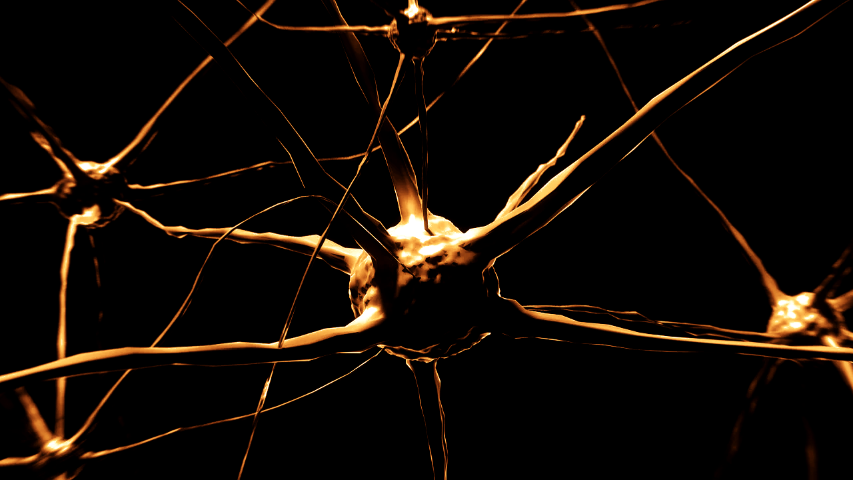
What is Deep Learning?

Slide 2
Artificial intelligence
Machine learning
Deep learning

Slide 3
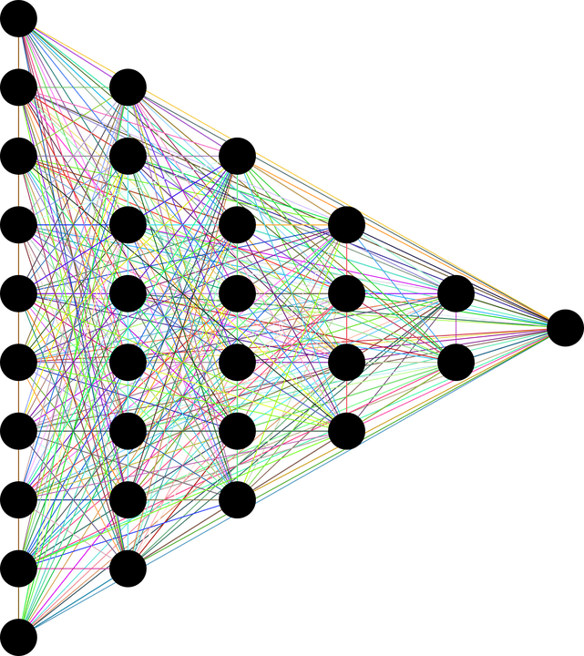
What is “deep”?
Circuits are typically organized in many layers
  Computation paths from inputs to outputs have many steps

Slide 4
Rise of deep learning
Data availability
Compute resources
Algorithmic innovation

Slide 5
Large neural network
performance
Small neural network
Traditional machine learning
data

Slide 6
How do you improve performance?
Increase training data
Increase neural network size

Slide 7
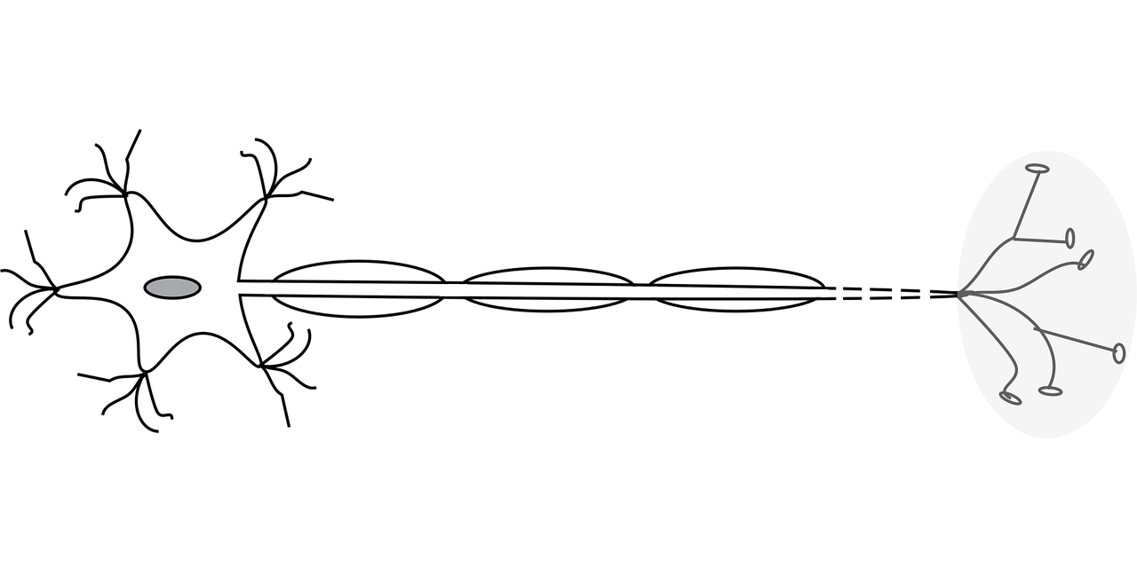
Deep learning structure
Multi layered structure called neural networks

Slide 8

What is the basic idea of deep learning?
Train circuits with long computation paths
  Allows all input variables to interact in complex ways
  Each variable can interact with all others

Slide 9
Shallow model

Slide 10
Deep learning model

Slide 11
Coming up…
What is a Neural Network?

